Slide 1

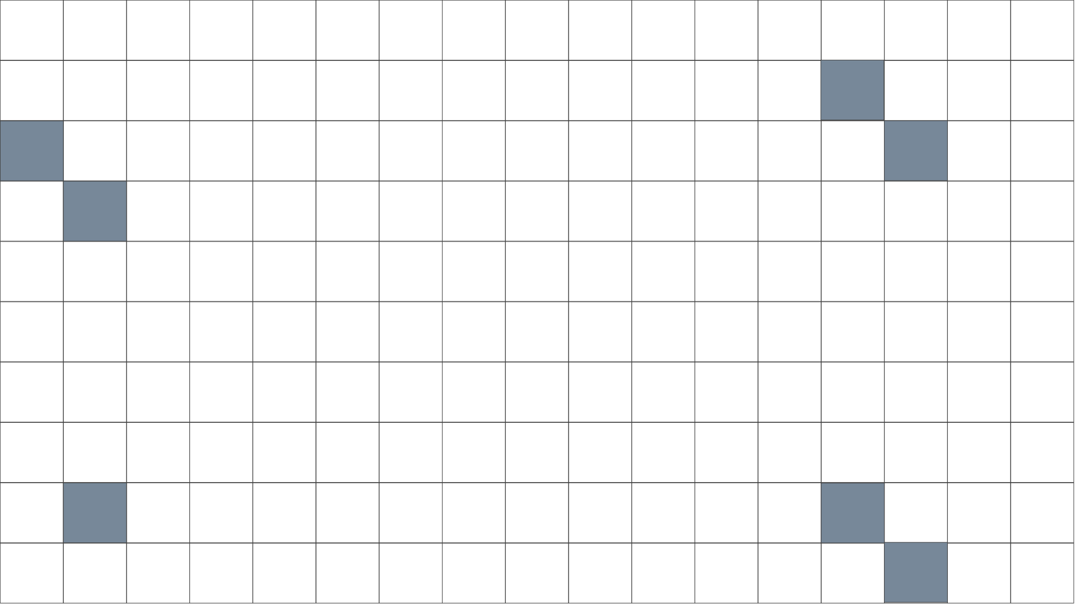



M
A
LABYRINTH
Z
R
O
U
T
E
R
Youssef Elhagg
Nour Kasaby
Nadine Safwat
Mariam ElGhobary

Slide 2
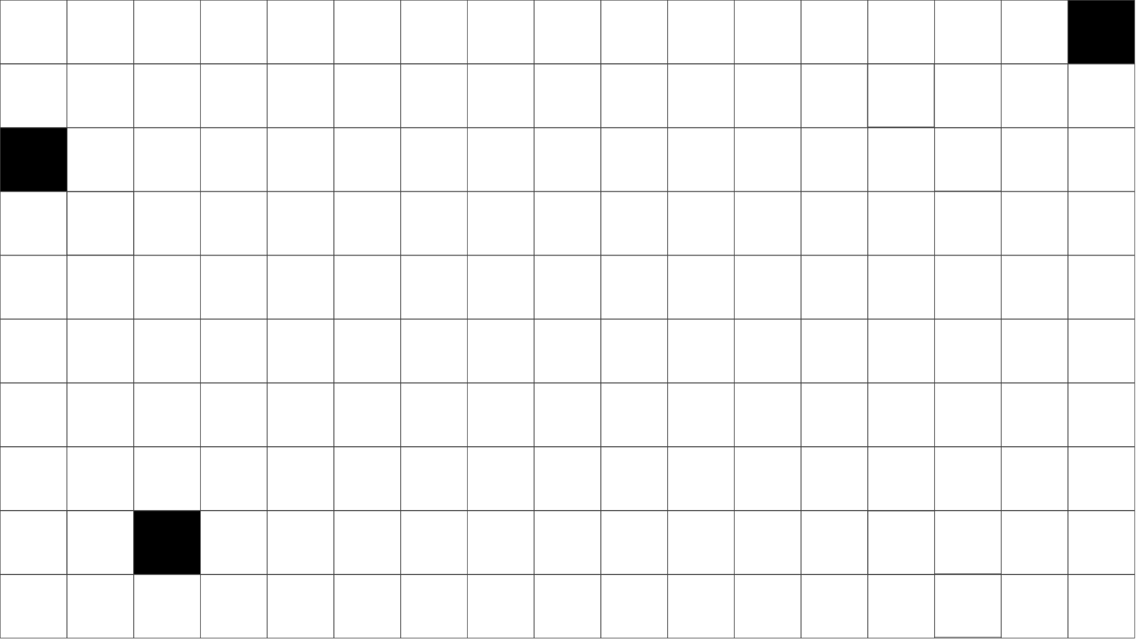
Project Description
This project aims to develop a maze router—a type of routing algorithm designed to establish paths between multiple points on a grid-based layout while navigating obstacles and minimizing routing costs. This maze router is specifically tailored for a two-layer routing environment, where it will manage multi-point connection (nets) and optimize routes across two layers, M0 and M1, which have distinct directional preferences: M0 is optimized for horizontal routing, and M1 for vertical.

Slide 3
Lee’s Algorithm
Lee's Algorithm is a breadth-first search algorithm used for maze routing. It works by systematically exploring all possible paths from the start point until it reaches the end point, ensuring the shortest path is found. The algorithm fills the maze grid with distance values from the start point and then backtracks from the end point to construct the path.
We chose to implement this algorithm specifically because:
It is easy to implement.
It always finds the shortest path.
We are well versed in how it works.

Slide 4

Net Ordering Bonus
We implemented the net ordering heuristic of prioritizing the net with the minimum Manhattan distance between the source and target. Such an approach offers great congestion management in a simple and computationally efficient way.

Slide 5
Input File Format
Example:
100, 200, 20, 5 // grid width, grid height, bend pen, via pen
OBS (0, 33, 44)
OBS (1, 55, 77)
net1 (1, 10, 20) (2, 30, 50) (1, 5, 100)
net2 (2, 100, 200) (1, 300, 50)
net3 (1, 100, 50) (2, 300, 150) (2, 50, 50) (1, 2, 2)

Slide 6
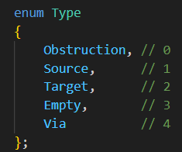
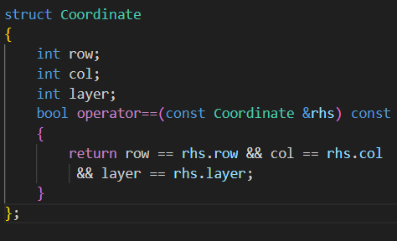
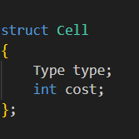
Data Structures
Since we used C++ we wanted to utilize OOP by creating a Maze Router class. Each file containing a set of nets will have its own object with built in functions which execute the routing algorithm. We also defined the following structs and enum:

Slide 7
Grid Initialization
Our grid is defined as follows:
unordered_map<int, vector<vector<Cell>>> grid;
where the key specifies the metal layer and for each layer we have a 2 dimensional set of cells with the dimensions specified in the file.
We start off by reading our input file, ordering the nets and then for each net we set the cells to their appropriate type via our type enum.

Slide 8
Implementation: Filling
Our aim was to have our code mimic how Lee’s algorithm works by hand. This was done through the following steps:
We begin with a vector of our sources
For each source we fill the surrounding cells accordingly
If an adjacent cell is found as a target we signal a hit and move on

Slide 9
Implementation: Backpropagation
Takes the coordinate of the hit tagert
It will observe the surrounding cells and choose the next cell as the one with the lowest cost
If the cell is marked as a Via we automatically switch layers
These steps are repeated until we find a source

Slide 10
Visualization
We leveraged the power of NextJS to develop a beautiful visualization tool “Labyrinth”.
We utilized other libraries such as TailwindCSS and DaisyUI to style the app to our needs.
Labyrinth allows you to visualize the routes for both Metal Layers, for all nets, each having multiple targets.
It allows you to select which nets you would like to display.

Slide 11
Testing
We tested our router using 8 test cases that cover different cases that may arise and validated the output manually.
Test 1: 1 net with 1 target in the same layer
Test 2: 1 net with 1 target but the obstacles block the source from reaching the target
Test 3: 1 net, 2 targets on different metal layers (bend penalty higher than via)
Test 4: multiple nets, multiple targets

Slide 12
Testing
The following tests were done for milestone 2 specifically mainly to test the bonus (Manhattan distance sorting)
Test 5: multiple nets, one target
Test 6: Bend penalty is much higher than via penalty
Test7: Source cannot ever reach the target
Test 8: multiple nets, multiple targets

Slide 13
D
T
H
A
N
K
Y
O
U
:)
C
T
O
R

